Slide 1
Interpreting and Using ACT Aspire Summative Results
Spring 2018 Test Administration

Slide 2
Please LOCATE the ASPIRE RESULTS sent to you back in August

Slide 3
Archdiocese of Chicago Academic Improvement Goals
Reading and Math
Student are to learn the Archdiocese of Chicago Curricular Benchmarks in English/language arts and math. As measured by meeting or exceeding ACT Aspire College Readiness Benchmarks: “ready” or “exceeding”
Student growth from one year to the next is “high” or above the expected level of performance

Slide 4
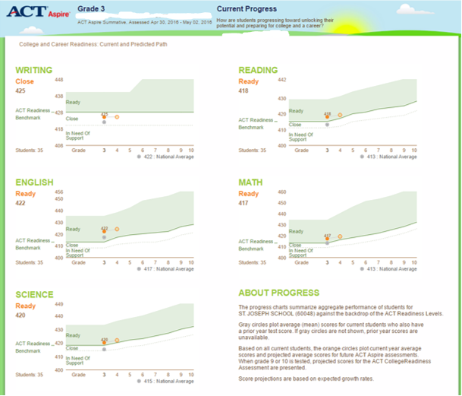
Questions about how to read Current Progress Report

Slide 5
Objectivity/Specificity Matrix

Slide 7
Practice: Using Current Progress
Analyze the Current Progress report using the “I notice/I wonder” protocol
Write specific and descriptive “I notice” statements
Write specific and descriptive “I wonder” questions

Slide 8
Directions
Find the following reports for your grade
Supplemental Scores
Subject Proficiency by Student
Skill Proficiency (choose reading, math, or science)
Proficiency Summary (choose reading, math, or science)

Slide 9
What is the bar for meeting the standards?
Access the ACT Aspire Readiness Level Ranges
Access the ACT Aspire Performance Level Descriptors

Slide 10
Assessments Measure Standards
ACT Aspire measures the Archdiocese of Chicago Curricular Benchmarks
Identify the lowest performing strands in your content areas – what can be accomplished in trimester one and beginning of two
Interims taken right after Christmas break

Slide 11
Identify the Skills Students Found Most Challenging
Access the AoC Curriculum Benchmark Reports
Identify the skills for the lowest performing strand
Access the Complexity Report
What do you notice about the complexity of the skills in the strand
Access the Sequence Report
Identify when the skills are taught and assessed

Slide 12
Goal Sheets Needed For Each Grade Level
Due by the end of the day today

Slide 13
Thank you for all that you do on behalf of Catholic schools!!

